Slide 1
3D Object Representation

Slide 2
3D Object Primitives
Primitives are three-dimensional geometric shapes that are the building blocks for creating complex geometric objects. You can use them to create 3D objects from scratch; the models are much simpler and typically consume fewer runtime resources than those you import from external 3D modeling packages. (In a 2D, instead of primitives, you work with shapes.
Primitives can be manipulated: moved, rotated, grouped, hidden, and even transformed from one shape into another. Primitives are often what you assign dynamics to. Dynamics include data display, animation, pick actions, and other forms of activity; indeed, in GraphWorX64 any object can have dynamics. Each primitive has property values that determine appearance, behavior, and other features of the object.
Common 3D Primitives: (a) Cube. (b) Cylinder. (c) Tube. (d) Sphere. (e) Torus. (f) Cone.

Slide 3
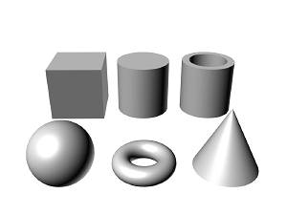
Common 3 D Primitives

Slide 4
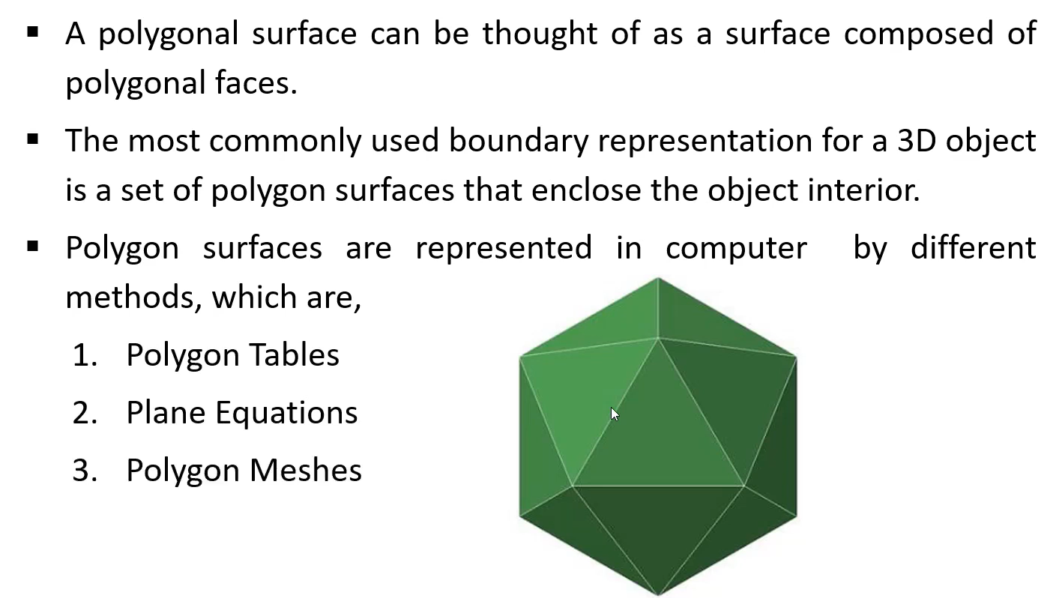
Polygon Surfaces

Slide 5
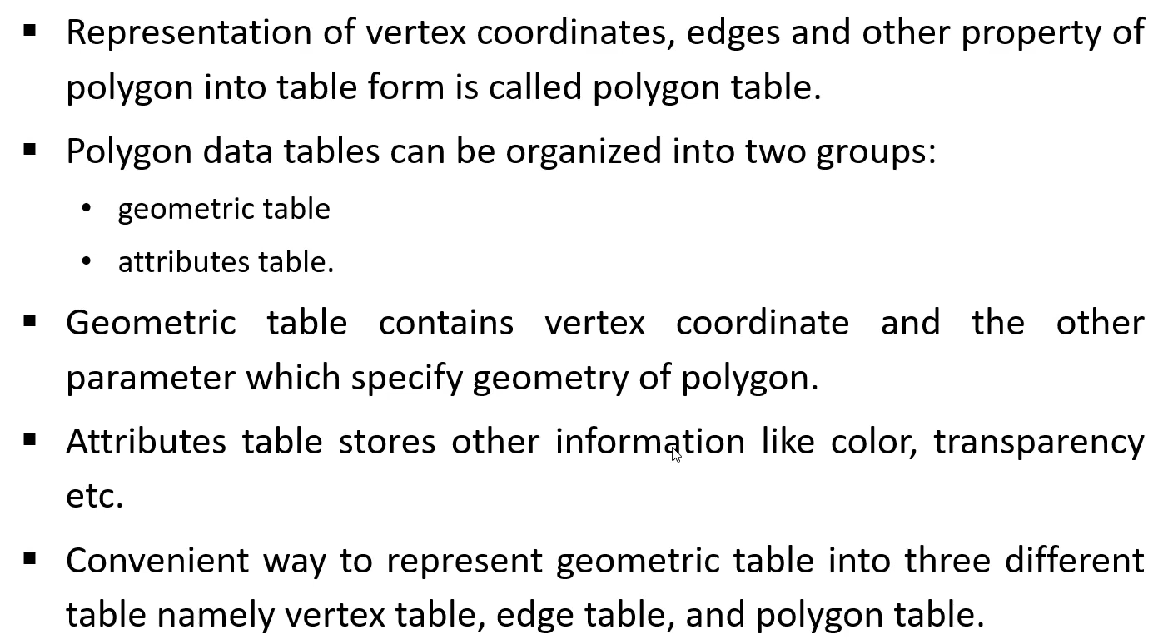
Polygon Tables

Slide 6
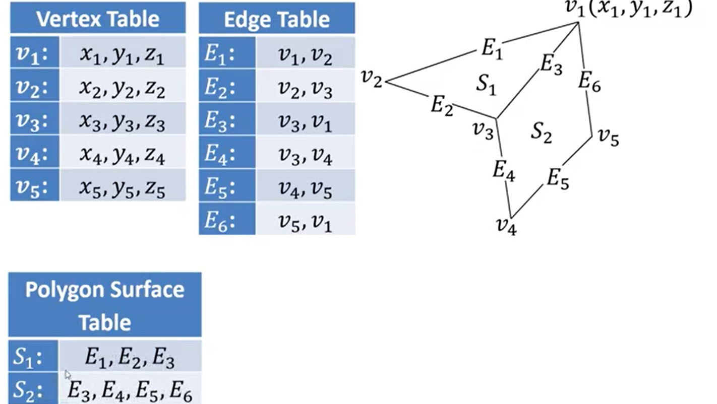
Polygon Tables (Continued…)

Slide 7
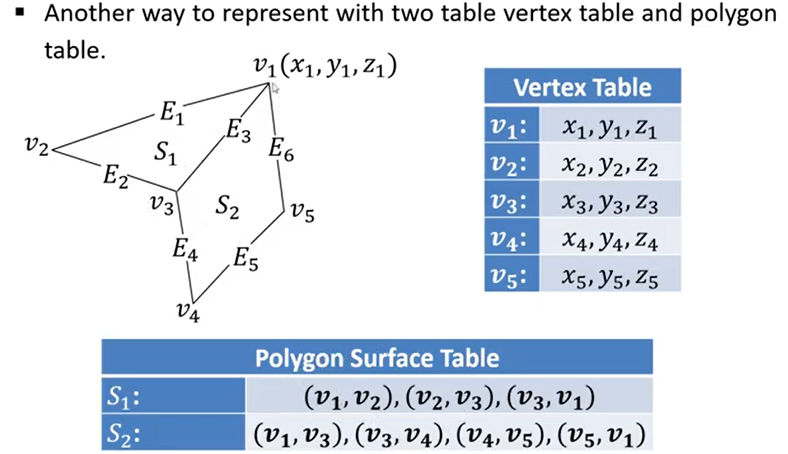
Polygon Tables (Continued…)

Slide 8
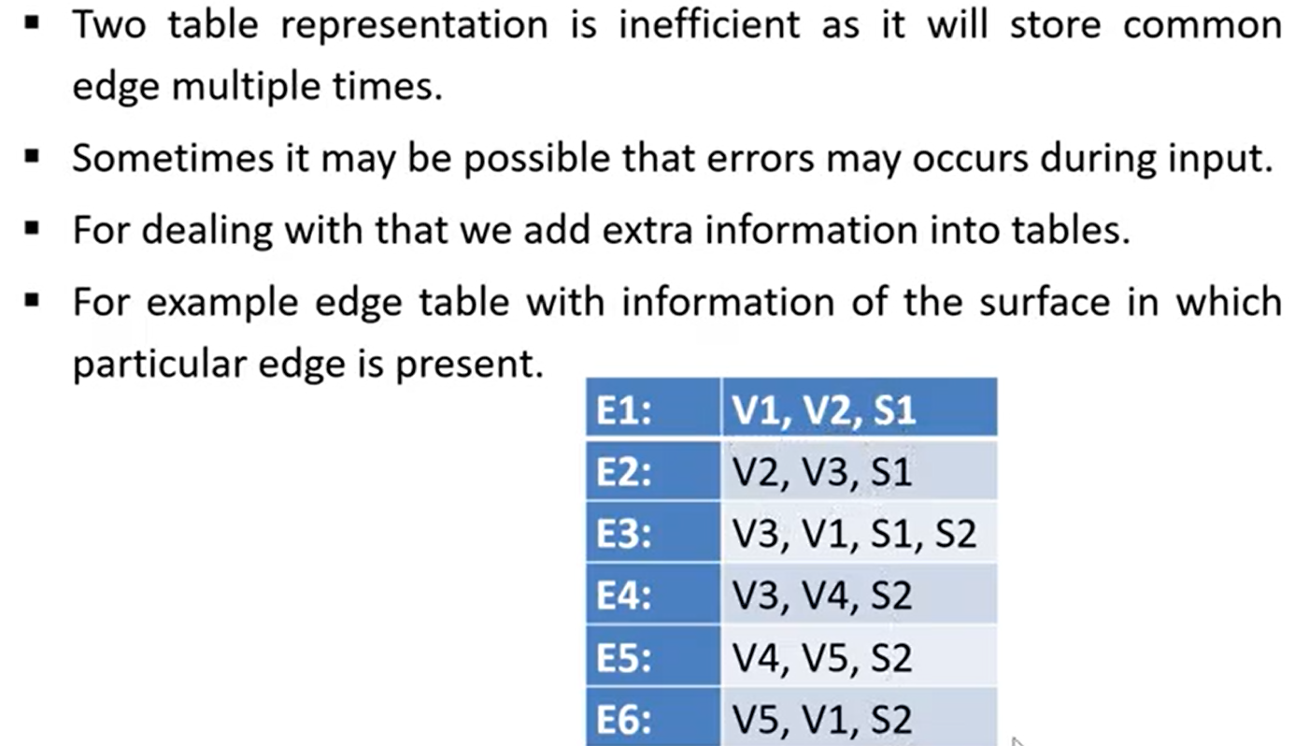
Polygon Tables (Continued…)

Slide 9
Quadric Surfaces
Quadric surfaces are defined by quadratic equations in two dimensional space.
Spheres, Ellipsoid and cones are examples of quadrics.
The quadric surfaces are surfaces of revolution in which a finite curve in two dimensions is swept in three dimensional space about one axis to create a surface.

Slide 10
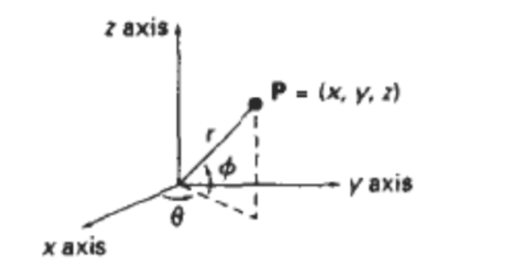
Various types of Quadratic surfaces:-
Sphere :- A sphere with radius ‘r’ is defined as the set of points(x,y,z) , that satisfies the following equation:
x² + y² + z² = r²

Slide 11
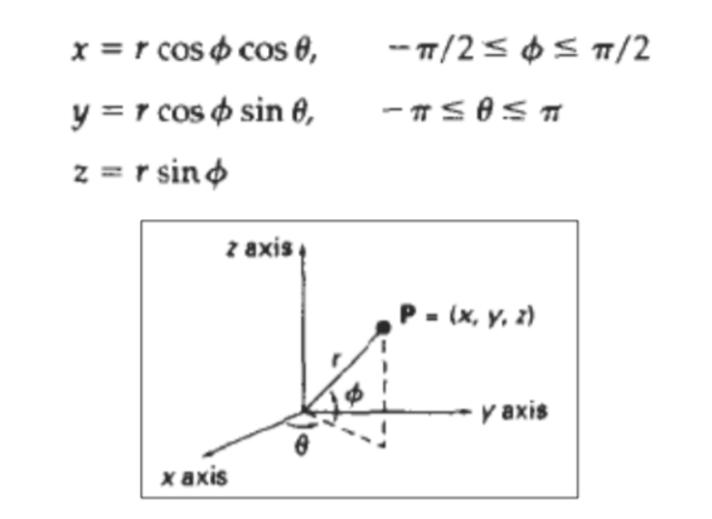
Sphere in parametric form :- We can also describe the spherical surface in parametric form, using latitude and longitude angles.

Slide 12
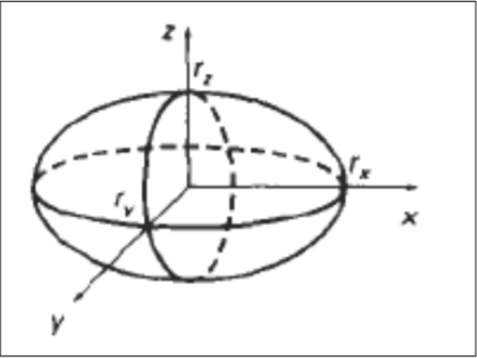
2. Ellipsoid :-
An ellipsoidal surface can be described as an extension of a spherical surface, where the radii in three mutually perpendicular directions can have different values.

Slide 13
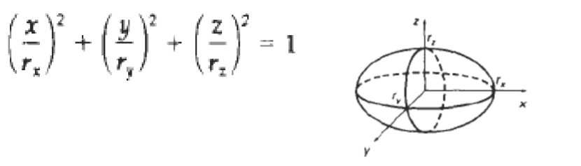
The Cartesian representation for points over the surface of an ellipsoid centred on the origin is:-

Slide 14
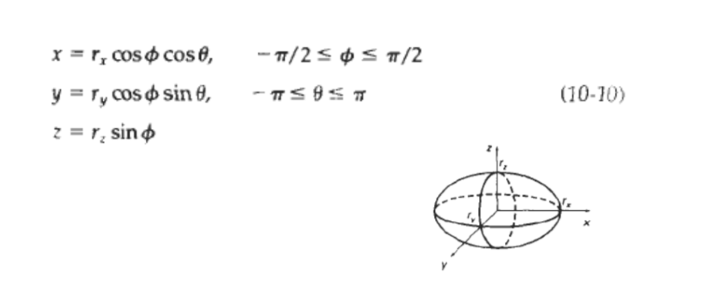
Parametric representation of Ellipsoid is: -

Slide 15
Polygon Meshes
Polygon Mesh
A polygon mesh is a mathematical representation of a 3D object. It is composed of a set of vertices, edges, and faces that define the shape of the object. A vertex is a single point in 3D space, an edge is a line connecting two vertices, and a face is a closed loop of edges. The faces are usually triangles or quadrilaterals, and can be used to represent curved surfaces or other complex shapes.
Uses of Polygon Mesh
Polygon mesh has a wide range of applications in computer graphics. It can be used to represent a variety of shapes, from simple cubes to complex characters. The mesh can be manipulated to create realistic images, animations, and simulations.
Polygon mesh can be used to create 3D models for games and films. The mesh can be modified to create realistic characters and environments. It is also used in virtual reality applications, as it allows users to interact with a 3D environment.
Polygon mesh can also be used to create 3D printing models. The mesh can be manipulated to create intricate designs for 3D printing.

Slide 16
Advantages
Polygon mesh has several advantages over other 3D modeling techniques. It is relatively easy to use and understand. It is also highly efficient, as it requires fewer polygons to create a 3D object than other techniques.
Polygon mesh is also versatile. It can be used to create a wide range of shapes, from simple cubes to complex characters. It can also be used to create 3D printing models, as well as realistic animations and simulations.
Polygon mesh is highly scalable. It can be used to create 3D models of any size, from tiny objects to large structures.
Applications
It is used in computer games and animation. Due to its lightweight nature, it is well-suited for real-time applications. It is also used in virtual reality, where it is used to create virtual environments.
It is used in CAD applications. It is used to create 3D models for engineering and manufacturing projects.
It is used in medical imaging. It is used to create 3D models of the human body for medical research and surgery planning.

Slide 17
Blobby objects :-
Some objects do not maintain a fixed shape
They change their surface characteristics in certain motions
These objects are referred to as blobby objects, since their shapes show a certain degree of fluidity
Examples in this class of objects include :-
1. water droplets
2. melting objects
3. muscle shapes in the human body.

Slide 18
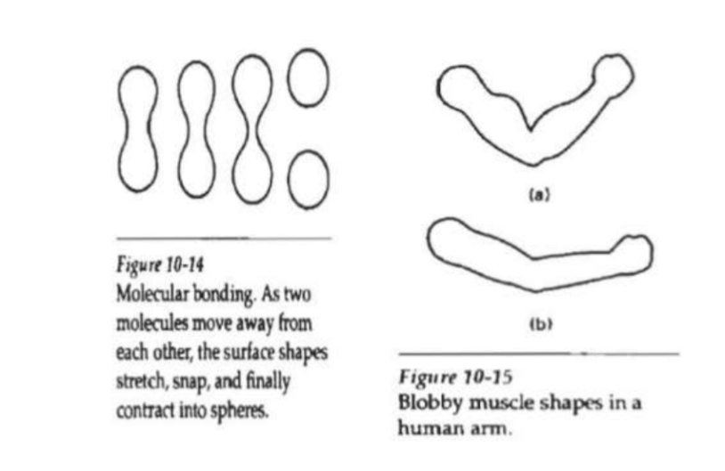
Blobby objects :-

